Slide 1
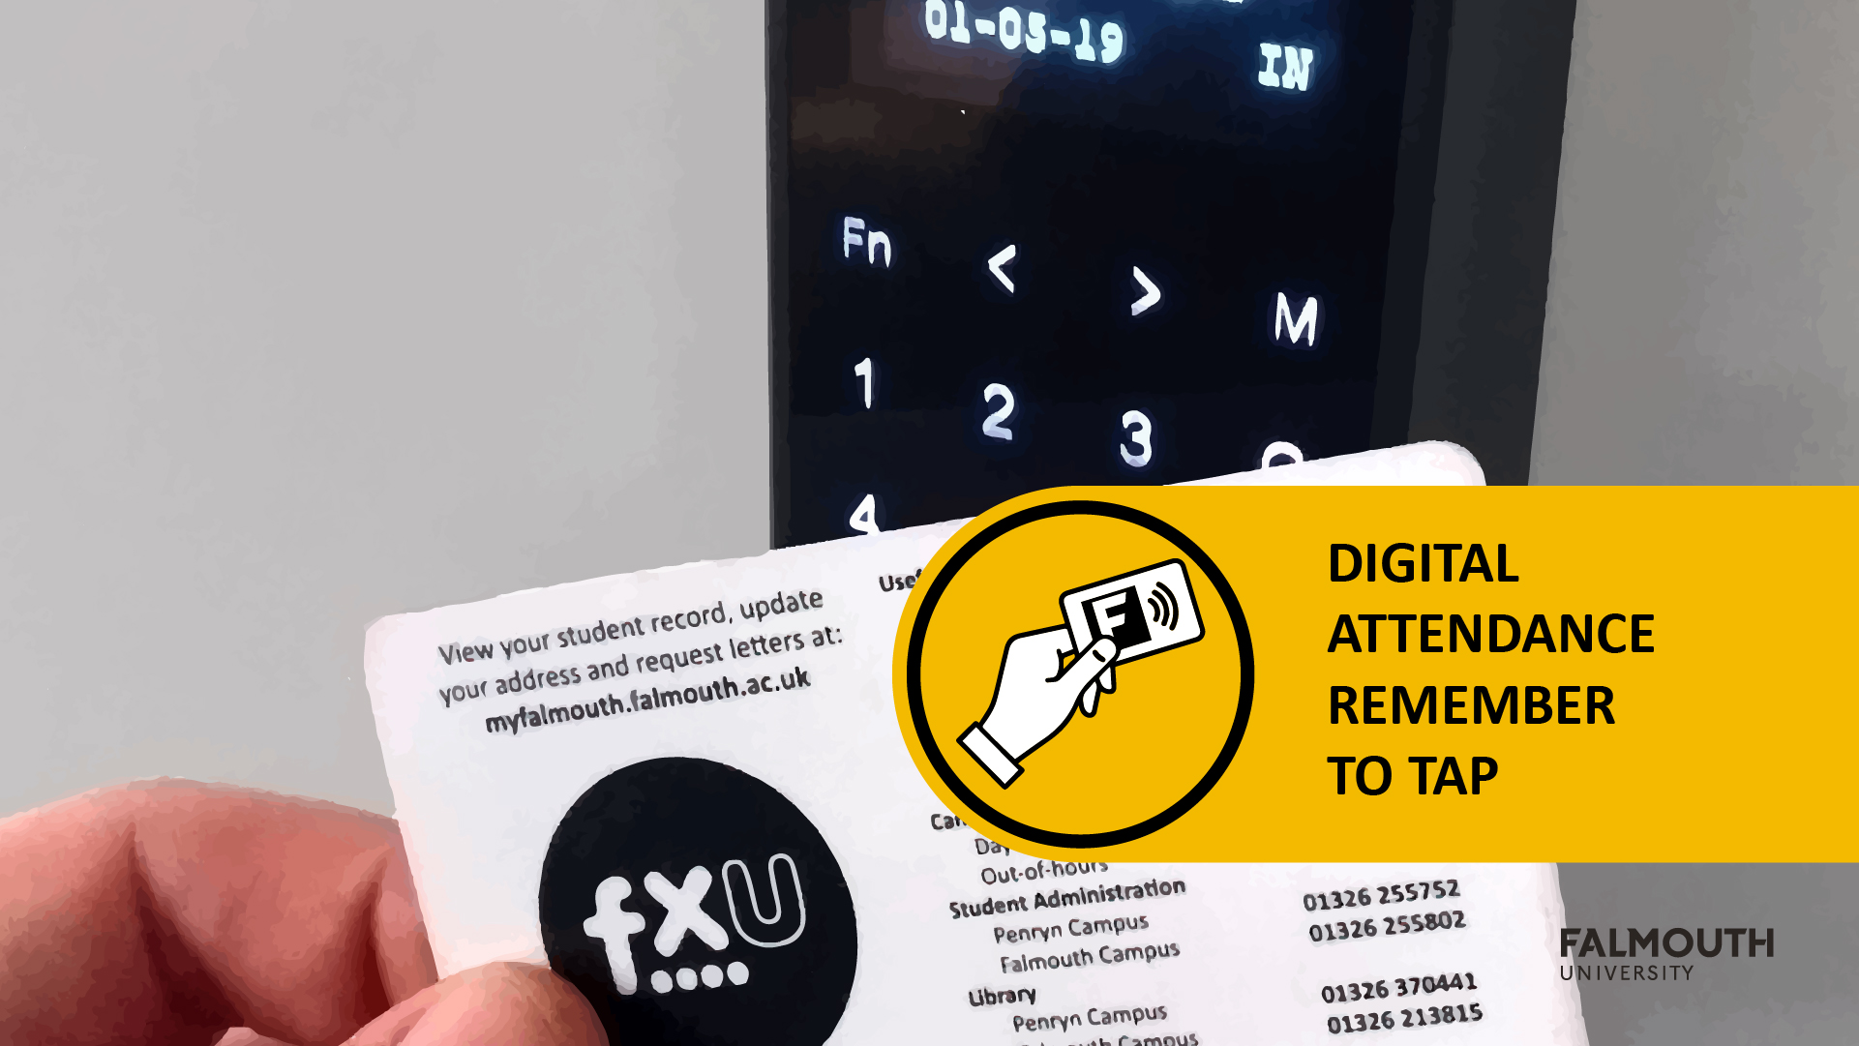

Slide 2


GAM130 –
Moving
Online

Slide 3
Introduction
Since we have now moved to online teaching there are few things we should cover:
Assignment
Expo Replacement
Tips and Techniques to work remotely
First off communication
We are using Microsoft Teams for all teaching online
Download - https://products.office.com/en-gb/microsoft-teams/download-app
We have a Teams Site for you all - https://bit.ly/2UvEhlJ
Students have also setup a Discord - https://discord.gg/4Smtuy

Slide 4
How your teaching is changing?
We will setup up the following sessions
Lecture – Microsoft Teams Live Events
Workshops – Microsoft Teams Meetings
Tutorials –Microsoft Team Meetings or Chats (Private Messaging)
Studio Practice – Staff will be available on Discord and Teams, please ‘@’ and they can setup MS Team Meetings to support
These will align with your timetabled sessions, and you will receive an invite via email ….. PLEASE CHECK YOUR EMAIL
If you don’t receive an invite, please ‘@’ the Tutor on Teams

Slide 5
PLEASE CHECK YOUR EMAIL!!!!

Slide 6
Assignment

Slide 7
Assignment Breakdown
Assignment 1 – Studio Practice
Some changes, mainly expo materials (more on that later)
Assignment 2 – Evaluation
No changes!
No student will be disadvantage for this move to online
All Supervisors have been instructed to take the new situation into account
We will also use our academic judgement to ensure you get the mark you deserve

Slide 8
Assignment 1 – Studio Practice
The assignment mostly stays the same
The Collaborate learning outcome is still be assessed on how you work as a team
Team Working
Version Control
Agile Practice
Reflection
The Deliver learning outcome is still be assessed on the quality of the game
However the Expo Materials have been dropped and replaced with Promo Material

Slide 9
Expo Materials – Game Standees
These small stands will be used to explain your game and the controls
Think of it as a summary that someone would browse on a game box or on a steam/itch.io page
The standee should also feature the game controls, please consider making this easy to read and not just a block of text
Please provide a QR which points to an itch.io page or similar
We will provide a PSD template for this:
https://learningspace.falmouth.ac.uk/mod/resource/view.php?id=60914
The Games Academy will print these for you!

Slide 10
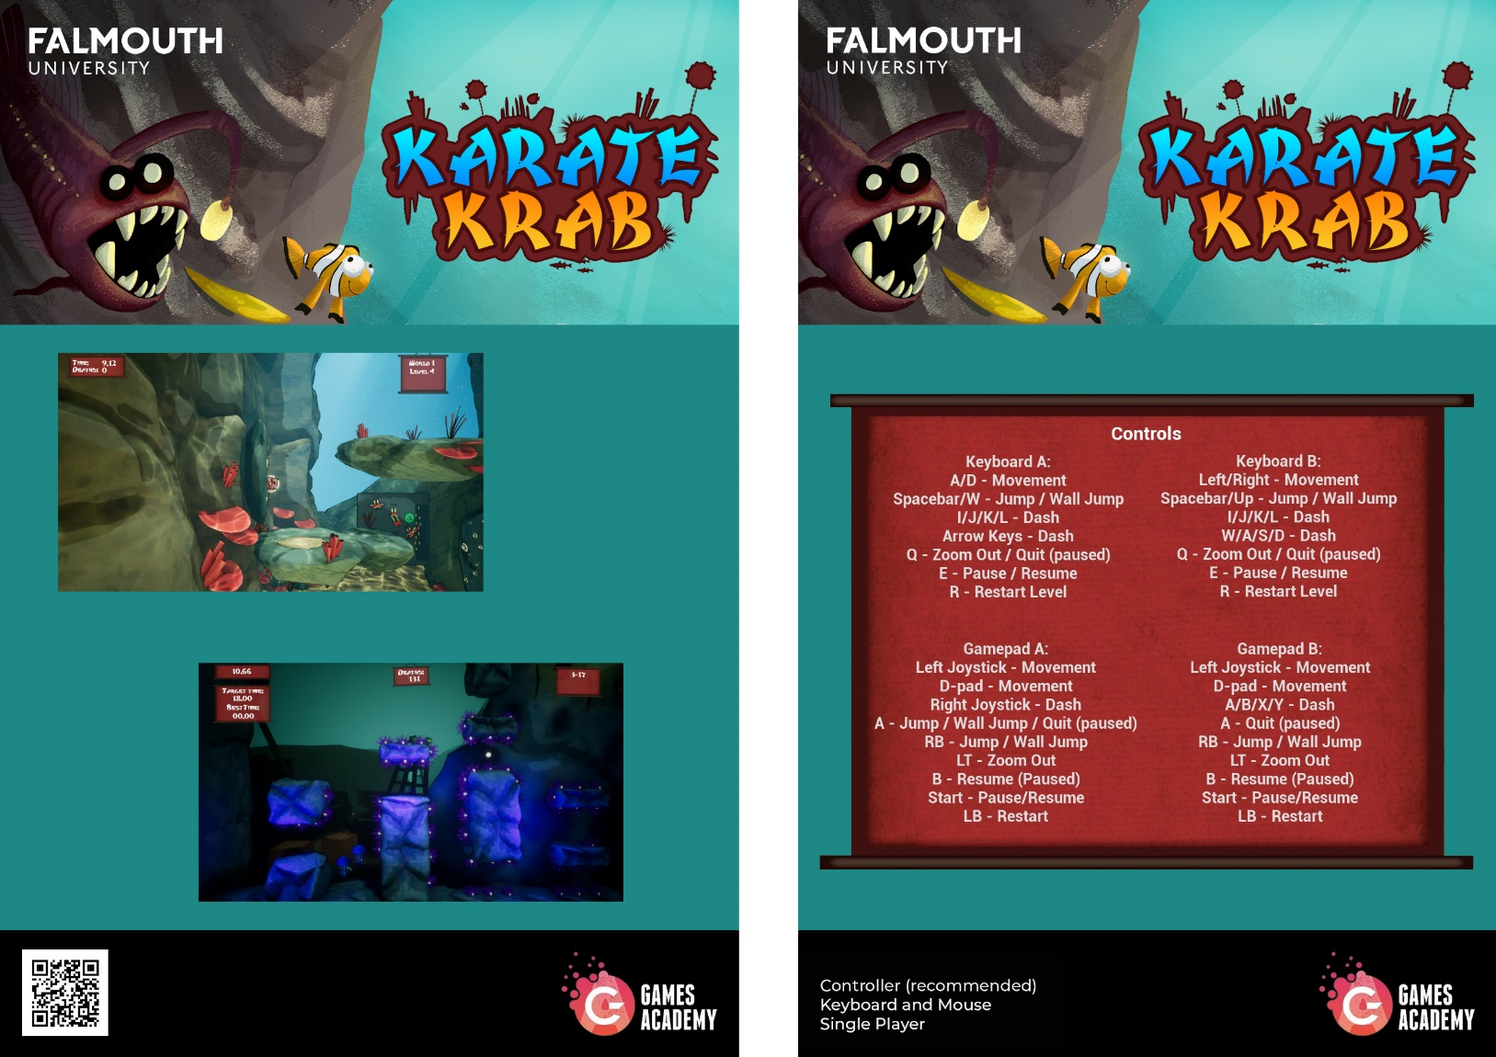
Expo Materials – Game Standees

Slide 11
Expo Materials – Game Standees

Slide 12
Expo Materials – Game Standees

Slide 13
Online Working Tips

Slide 14
Useful Links
Expert Advice: A Guide to Working Remotely in Games- https://gamasutra.com/blogs/DavidLogan/20200319/359737/Expert_Advice_A_Guide_to_Working_Remotely_in_Games.php
The Pomodoro Technique - https://lifehacker.com/productivity-101-a-primer-to-the-pomodoro-technique-1598992730

Slide 15
Questions?

